Slide 1



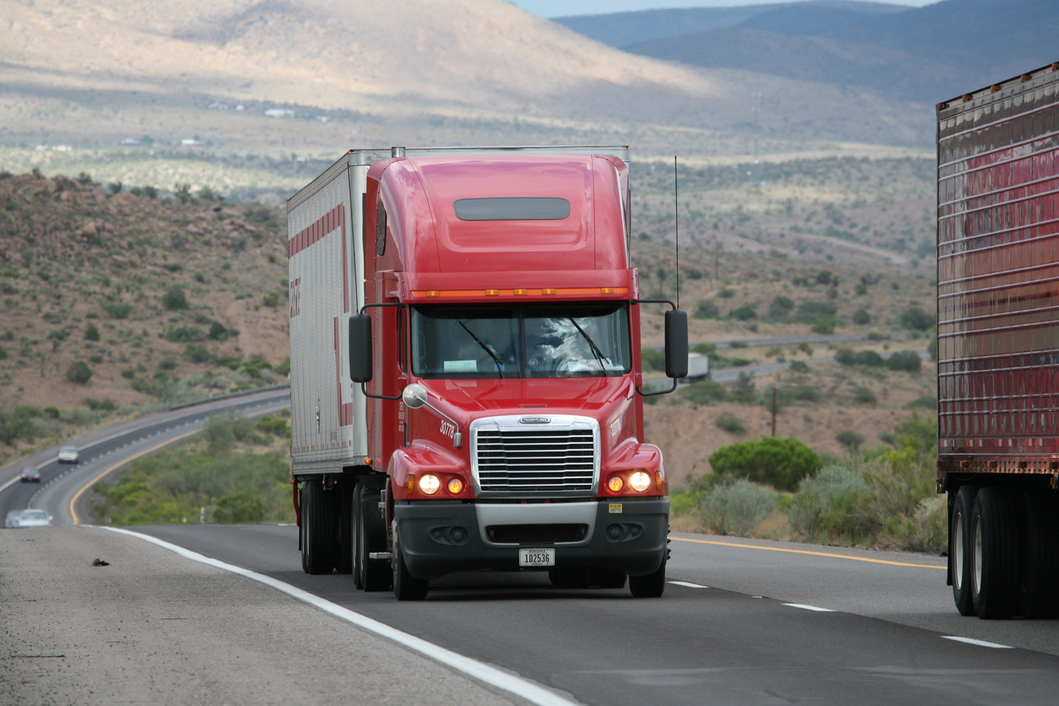

Reliable Transportation. Safe Handling. Seamless Delivery.
COMPANY PROFILE
CONTACT US
0930 307 6342 09075478946

Slide 2
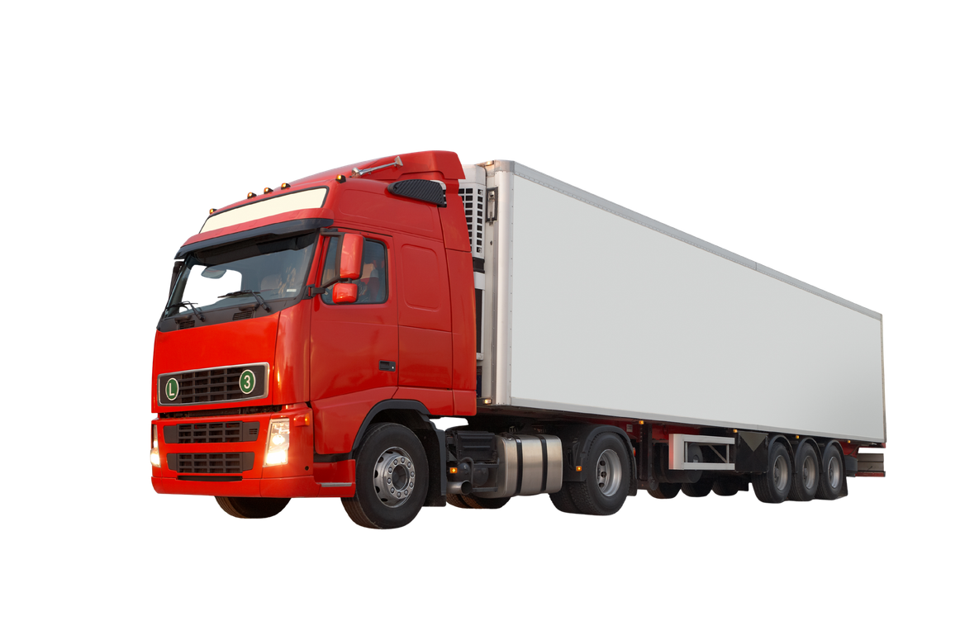

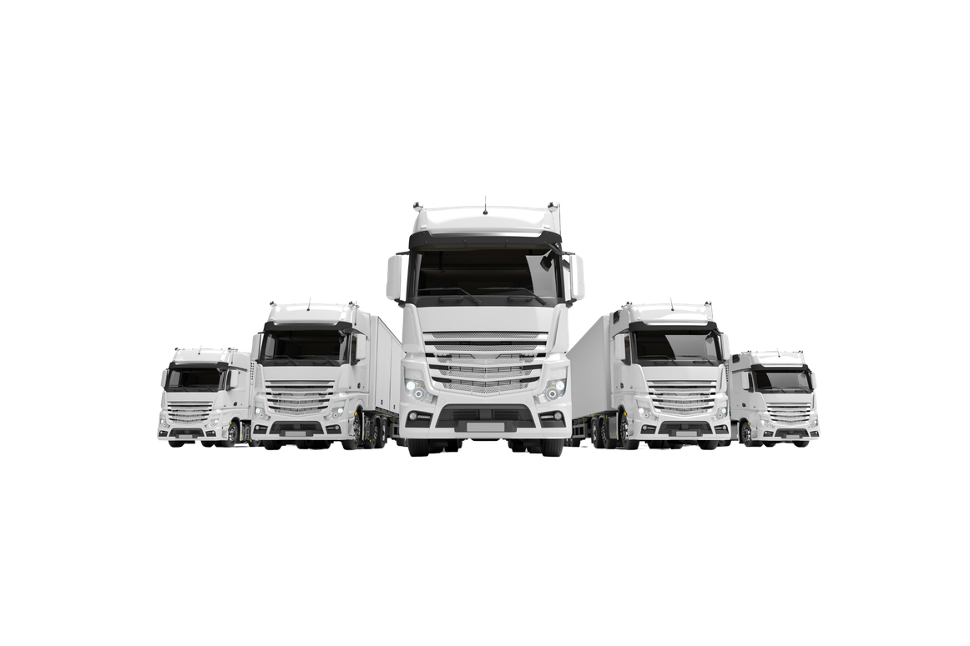
ABOUT US
MKP TRUCKING SERVICE is a forward-looking transportation and logistics service provider dedicated to delivering reliable, efficient, and convenient trucking and moving solutions to meet the business and personal needs of individuals, families, businesses, and commercial establishments.
We take pride in pioneering simple, complete, and specialized moving services through the use of our trucks equipped with hydraulic lifters, designed to make loading, unloading, and transporting goods more efficient, convenient, and secure.
We specialize in residential moving, condominium relocation, office transfers, warehouse relocation, and the transportation of various goods, construction materials, medical supplies, and telecommunications equipment. Our services are designed to accommodate a wide range of moving and transportation requirements, providing practical and dependable solutions for every client.
We understand that every relocation and delivery comes with unique requirements. Whether transferring household belongings to a new residence, relocating an entire office, moving warehouse inventory, or transporting essential business supplies, our goal is to provide organized, efficient, and dependable transportation solutions tailored to our clients' specific needs.
At MKP TRUCKING SERVICE, we value customer satisfaction, professionalism, safety, and responsible cargo handling. We are committed to providing a smooth, convenient, and stress-free moving and delivery experience by ensuring that every transport requirement receives proper attention and care.

Slide 3


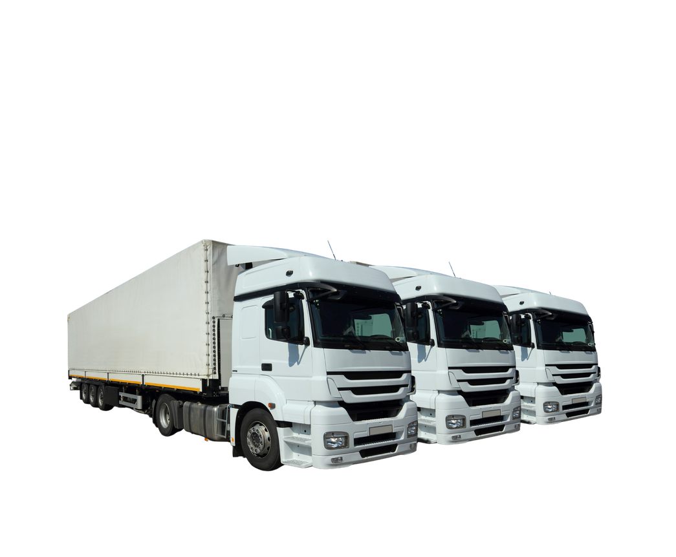
Our Vision
To become a trusted and preferred trucking and logistics service provider, recognized for dependable transportation solutions, professional customer service, and a commitment to helping individuals and businesses move their belongings and goods efficiently and securely.
We envision building long-lasting relationships with our clients by consistently delivering services that meet their expectations and support their changing transportation needs.
Our Mission
To provide accessible, reliable, and customer-focused trucking services that make residential relocation, commercial moving, and goods transportation more convenient and efficient.

Slide 4

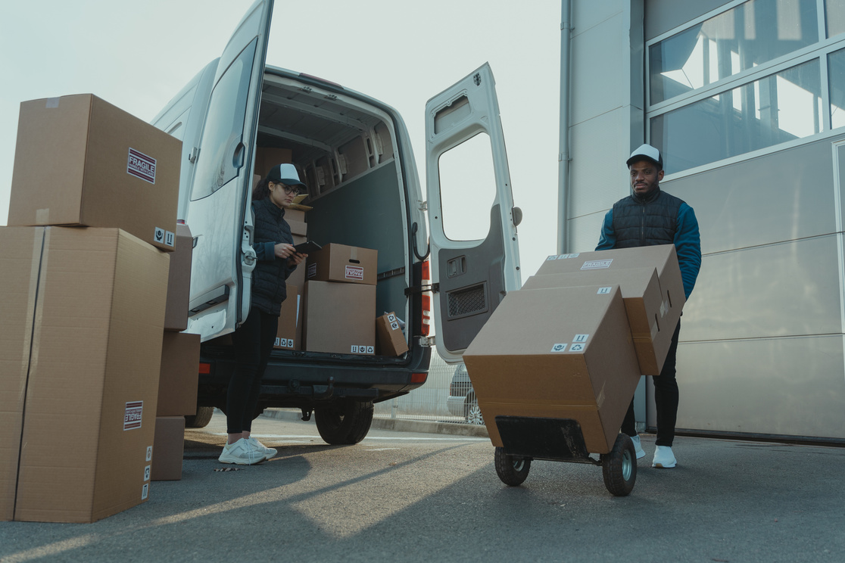
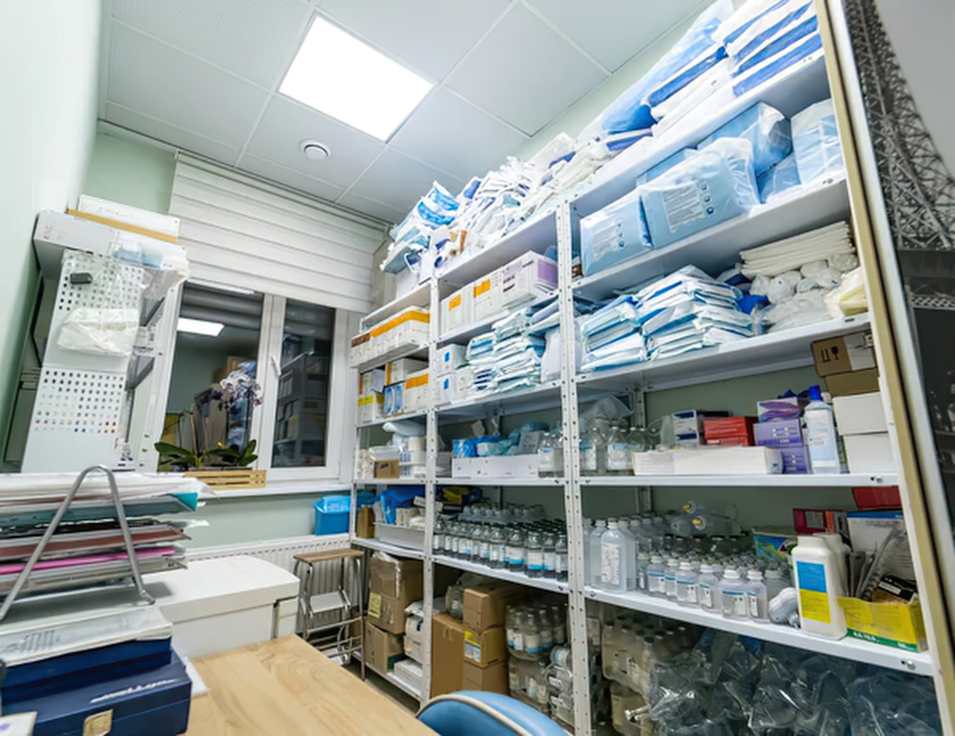
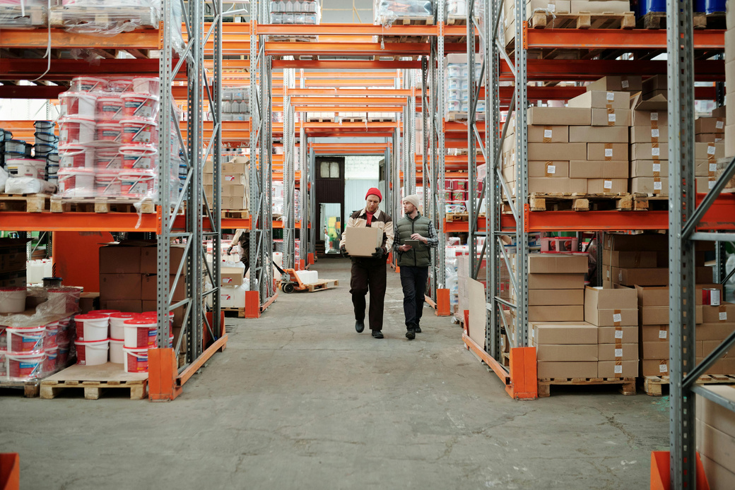
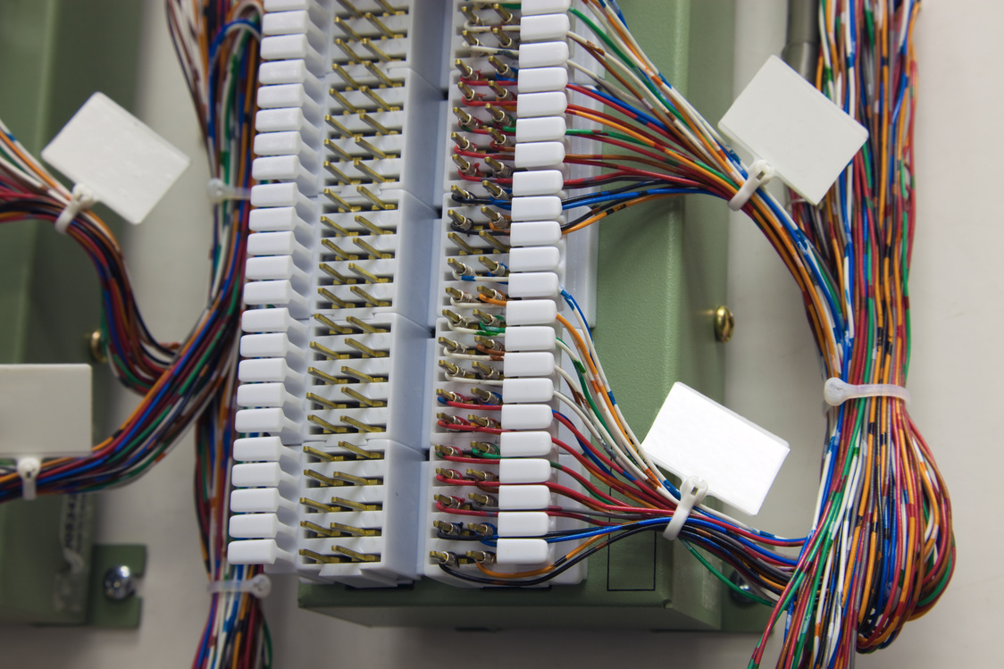
OUR SERVICES
Dependable Transportation for Everyday Business Needs
Efficient goods transportation plays an important role in maintaining business operations, supporting suppliers, and fulfilling customer requirements.
MKP TRUCKING SERVICE provides general goods delivery services for businesses, retailers, suppliers, and commercial clients requiring dependable trucking transportation.
Our services are intended to support the movement of products, merchandise, packaged goods, and other eligible commercial cargo between designated pickup and delivery locations.
GOODS DELIVERY SERVICES
Transportation Support for Healthcare Supply Needs
Medical facilities, healthcare providers, distributors, and suppliers require dependable transportation to support the availability of essential medical products and equipment.
MKP TRUCKING SERVICE offers trucking services for the delivery of appropriately packaged, non-hazardous medical supplies and healthcare-related materials.
We understand the importance of proper coordination when transporting products intended for clinics, hospitals, medical offices, pharmacies, and healthcare distribution facilities.
MEDICAL SUPPLIES DELIVERY
Supporting Smooth Business and Inventory Relocation
Warehouse relocation requires organized transportation to minimize operational disruption and facilitate the proper movement of inventory, equipment, and business materials.
MKP TRUCKING SERVICE offers trucking solutions for companies relocating warehouse items, commercial goods, and stored materials from one facility to another.
We aim to support business operations by providing dependable transportation arrangements suited to the nature and volume of the items being transferred.
WAREHOUSE TRANSFER SERVICES
Supporting Telecommunications Infrastructure and Connectivity
Telecommunications projects require the movement of equipment, devices, materials, and technical supplies between warehouses, business facilities, and project sites.
MKP TRUCKING SERVICE provides trucking and transportation services for telecommunications companies, suppliers, contractors, and service providers.
We aim to support telecommunications activities through organized transportation of appropriately prepared equipment and installation materials.
TELECOMMUNICATIONS (TELCO) EQUIPMENT TRANSPORTATION

Slide 5
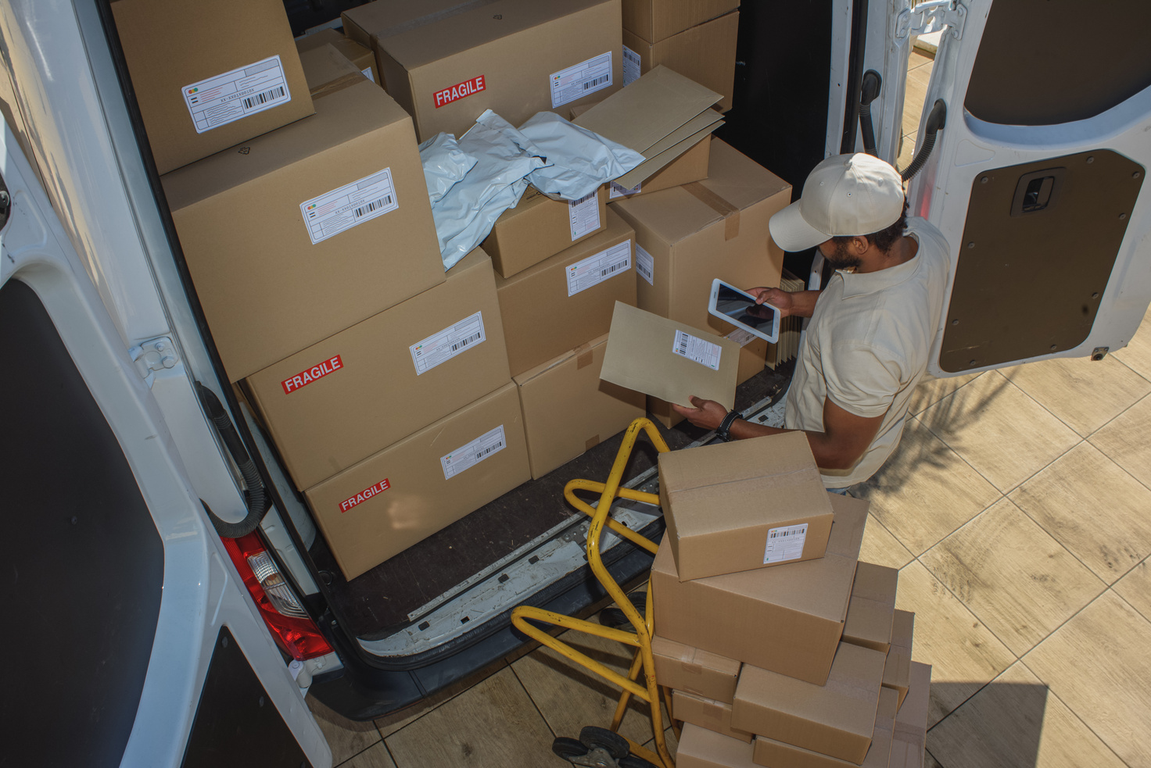



OUR SERVICES
Reliable Transportation Support for Construction Projects
Construction projects depend on the availability of materials and supplies to maintain productivity and meet project schedules.
MKP TRUCKING SERVICE provides delivery transportation solutions for construction suppliers, contractors, property developers, and project owners requiring the movement of construction-related materials.
Our services support the transportation of eligible building supplies and project materials from suppliers, storage facilities, or distribution points to designated construction locations.
CONSTRUCTION SUPPLIES DELIVERY
Helping Businesses Move Forward
Office relocation is a major undertaking that requires proper organization and transportation planning to reduce disruption to daily business activities.
MKP TRUCKING SERVICE provides transportation services for companies, offices, and commercial establishments relocating to new business locations.
We assist with the transportation of office furniture, workstations, filing cabinets, boxed documents, and other office equipment, subject to proper preparation and handling requirements.
OFFICE RELOCATION
Convenient Moving Solutions for Condominium Residents
Condominium relocation often requires additional planning due to building regulations, designated loading areas, elevator schedules, and property management requirements.
MKP TRUCKING SERVICE provides transportation solutions for condominium residents who need to move their furniture, appliances, household goods, and personal belongings.
We aim to coordinate transportation arrangements with clients to support an organized relocation process while considering the access requirements and moving schedules established by condominium management.
CONDOMINIUM RELOCATION
Making Every Move Easier and More Convenient
Moving to a new home is an important milestone, and transporting personal belongings requires preparation, coordination, and careful attention.
MKP TRUCKING SERVICE offers house moving or Lipat-Bahay transportation services to assist individuals and families relocating to a new residence.
Our services cover the transportation of common household items, including furniture, appliances, personal belongings, and other residential possessions.
Whether transferring to another neighborhood or moving to a different residential location, we aim to make the transportation process more organized, efficient, and convenient.
HOUSE MOVING / LIPAT-BAHAY SERVICES

Slide 6


WHY CHOOSE US?
VERSATILE TRUCKING SOLUTIONS
We cater to multiple transportation requirements, including household relocation, commercial transfers, general goods deliveries, and specialized industry supplies.
RESIDENTIAL AND COMMERCIAL SERVICES
Whether moving personal belongings or transporting business supplies, we offer services designed for individuals and commercial clients.
CONVENIENT TRANSPORTATION ARRANGEMENTS
We aim to provide straightforward service coordination based on pickup locations, destinations, cargo requirements, and preferred schedules.
COMMITMENT TO RESPONSIBLE HANDLING
We recognize the importance of proper cargo preparation, loading coordination, and careful transportation.
FLEXIBLE SERVICE APPLICATIONS
Our trucking services can support one-time relocations, individual deliveries, and arranged business transportation requirements, subject to availability.
CUSTOMER-CENTERED APPROACH
We value every service inquiry and strive to address customer transportation needs with professionalism and attention.
SUPPORT FOR BUSINESS OPERATIONS
Our transportation solutions help businesses move merchandise, equipment, inventory, and supplies between operational locations.

Slide 7

MOVING YOUR WORLD, DELIVERING YOUR NEEDS.
At MKP TRUCKING SERVICE, we believe that every successful move begins with dependable transportation and a commitment to customer satisfaction.
From personal household belongings to essential business supplies, we aim to deliver more than just transportation. We strive to provide convenience, reliability, and confidence in every journey.
MKP TRUCKING SERVICE — Moving with Purpose. Delivering with Commitment.
Let’s Connect with Us!
0930 307 6342 / 09075478946
OFFICE ADDRESS: 492 BKL17 KABISIG SAN ANDRESS CAINTA RIZAL 1900
GARAGE ADDRESS NO.018 SAMPAGUITA ST. HIGHWAY 2000 TAYTAY RIZAL COMMUNITY

